Slide 1
WEEK 7 · LECTURE 13
Building a Support Copilot
Part 1: the layer that reads
5,000 tickets a week, three agents, and nothing in the queue has ever been sorted. Let's ship anyway.
ISBA 2411 · Natural Language Processing & AI · Summer 2026
Notes:
[5:45 PM to 5:47 PM ~2 min]
Good evening. Last week we took a transformer apart to see how it works. Tonight we do the opposite: we build something with one.
By the end of these two lectures you will have a working support copilot, and more importantly you will know which parts of it you can trust.
Here is the situation we are walking into. Five thousand support tickets a week, three agents, and nothing in that inbox has ever been sorted or tagged by anyone. The standard advice is that you cannot use AI on a pile like that until somebody hand-sorts thousands of examples first. We are going to ship something useful tonight without sorting a single one.

Slide 2
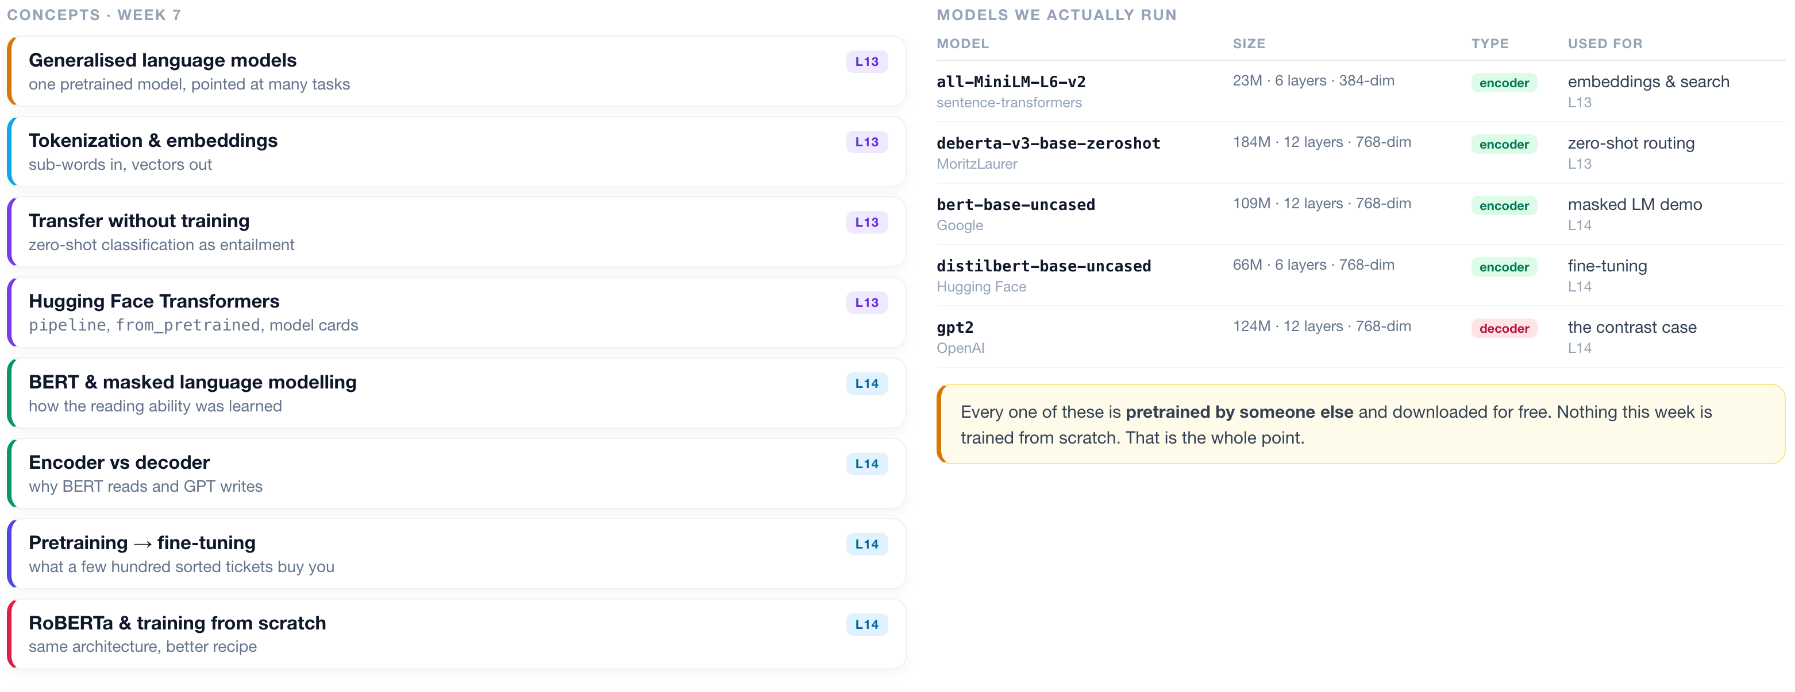
WEEK 7 · AT A GLANCE
Language Models & Transformers
What we cover across both lectures, the models we actually run, and what to read alongside them.
READINGS
J&M Ch. 7 Large Language Models
J&M Ch. 10 BERT & masked LMs
HOLLM Ch. 3 inside transformer LLMs
Tunstall Ch. 10 training from scratch
Vaswani 2017 Attention Is All You Need
Devlin 2018 BERT
Liu 2019 RoBERTa
ISBA 2411 · Natural Language Processing & AI · Summer 2026
Notes:
[5:47 PM to 5:50 PM ~3 min]
Before we build anything, here is the map of the week so you always know where you are.
On the left are the concepts. The ones tagged L13 are tonight. The ones tagged L14 are Thursday. Notice the split: tonight is about *using* models that already exist, and Thursday is about how they got that way and what happens when you adapt one to your own data.
On the right are the five models we actually run. Look at the sizes. Twenty three million parameters for the small one, a hundred and eighty four million for the biggest. These are tiny by modern standards, and every one of them runs free in Colab. And every single one was pretrained by somebody else. We just download them. That fact is the entire reason this week works.
At the bottom are the readings. Jurafsky and Martin chapter seven is generalised language models, chapter ten is BERT. Those two are the core. The titles are live links in the PDF on Canvas.

Slide 3
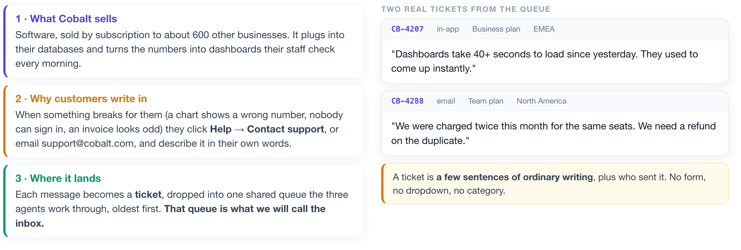
THE BUSINESS
First, what company are we walking into?
Before any technology, you need to be able to picture the job. Here it is in three sentences.
Five thousand of these arrive every week. Three people answer them.
ISBA 2411 · Natural Language Processing & AI · Summer 2026
Notes:
[5:50 PM to 5:54 PM ~4 min]
Before we touch any technology, you need to be able to picture the job. Three sentences.
First, what Cobalt actually sells. It is a software company. About six hundred other businesses pay Cobalt a monthly subscription to use its product, and that product plugs into their company databases and turns the raw numbers into charts and dashboards that their staff look at every morning. Think of the dashboard your manager checks to see how the week is going. Cobalt builds those.
Second, why customers write in. When something breaks for one of those six hundred companies, and something always breaks, they need help. A chart is showing a number they know is wrong. Nobody on their team can sign in. An invoice looks strange. So they click Help, then Contact support, right inside the product, or they email support at cobalt dot com. And they type out what went wrong, in their own words, the way you would write to a colleague.
Third, where that message lands. Each one becomes what the industry calls a ticket. It is not a physical thing; it is just their message, plus a note of who sent it, when, and which plan they are on. And every ticket drops into one shared work queue that the three support agents grind through, oldest first.
That queue is what I am going to call the inbox for the rest of tonight. Not your email inbox. This one specific queue of customer problems waiting to be answered.
Look at the two real examples on the right, because this is the whole data set in miniature. "Dashboards take forty plus seconds to load since yesterday." "We were charged twice this month for the same seats." That is all a ticket is: a couple of sentences of ordinary human writing. There is no form, no dropdown, no category. Just what somebody typed while they were annoyed.
Five thousand of these arrive every week. Three people answer them.

Slide 4
THE PROBLEM
Every ticket has to be read before it can be answered.
And that reading is where the three agents lose their day.
~5,000 tickets a week
~40% are repeats
Nothing is sorted
Minutes lost per ticket
and three people to answer them
the same handful of questions
no tags, no categories, just text
just working out who should own it
WHY THAT THIRD BOX IS THE HARD ONE
The normal way to teach a computer to sort text is to hand it a few thousand examples that a person has already sorted by hand. Those hand-sorted examples are called training data, and most machine learning cannot start without them. Cobalt has none. Building that pile would mean paying people to read and tag thousands of tickets before you could write a line of code.
So tonight we build something that never needs them. We start with the half that READS the inbox: search it, sort it, and decide what a person actually has to see.
ISBA 2411 · Natural Language Processing & AI · Summer 2026
Notes:
[5:54 PM to 5:57 PM ~3 min]
Now the problem. Every one of those five thousand tickets has to be read by a person before it can be answered, and that reading is where the day goes.
About forty percent of them are variations of the same handful of questions. And before an agent can do anything useful, they have to read the ticket, work out what it is even about, and decide who should own it. Billing or engineering? Urgent or not? That triage is a few minutes on every single ticket, five thousand times a week. That is the waste we are going after.
Now the constraint, and this is the one that makes it interesting. Look at the third box: nothing in this queue is sorted.
Here is why that matters, and if you have never done machine learning this is the sentence to hold onto. The normal way to teach a computer to sort text is to hand it a few thousand examples that a person has already sorted by hand. Somebody sits down, reads ticket one, and writes "billing". Reads ticket two, writes "login problem". A few thousand times. That pile of hand-sorted examples is called training data, and almost everything you have heard about machine learning assumes you have it.
Cobalt does not. Building it would mean paying people to read and tag thousands of tickets before you could write a single line of code. That is weeks of work and a budget nobody approved.
So the textbook answer is off the table, and that is the whole point of tonight. We are going to build something useful anyway. We start with the half of the product that reads the inbox. Thursday we make it act. And everything we do tonight works on any pile of text you have: tickets, reviews, resumes, survey answers, sales call notes.

Slide 5
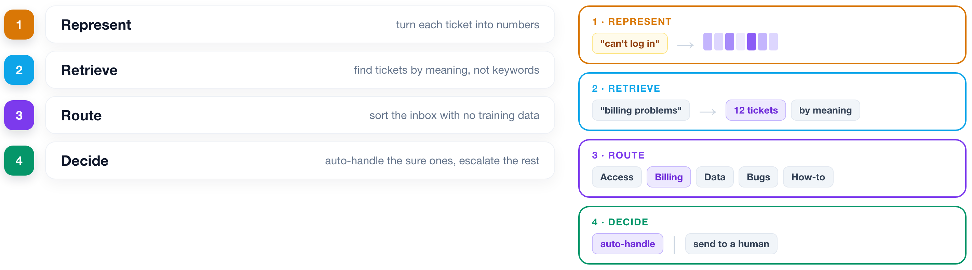
THE PLAN
Four capabilities, built in order.
Each one is useful on its own. Together they are a product.
ISBA 2411 · Natural Language Processing & AI · Summer 2026
Notes:
[5:57 PM to 6:00 PM ~3 min]
Four capabilities, built in order.
Represent: turn each ticket into numbers, because a model cannot read.
Retrieve: find tickets by meaning instead of by keyword.
Route: sort the inbox into buckets without any of that hand-sorted training data.
Decide: work out which decisions the system is allowed to make on its own.
Each one is useful by itself. You could stop after step two and have shipped something your support team would thank you for. Together they are a product.
Watch the numbered strip in the top right corner. It tells you which rung we are standing on.

Slide 6
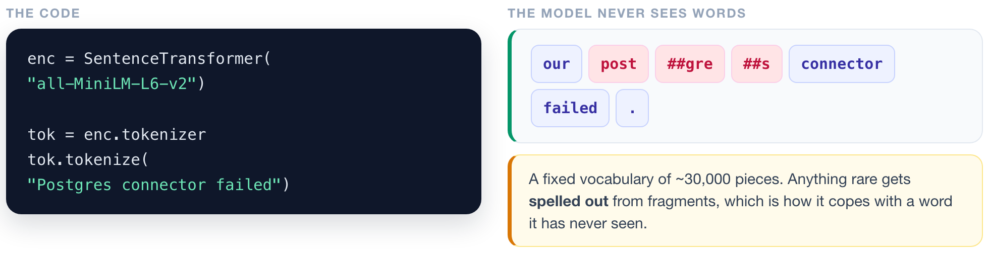
REPRESENT
1
2
3
4
A model cannot read. It can only do arithmetic.
▶ NOTEBOOK
STEP 6
Split text into tokens
ISBA 2411 · Natural Language Processing & AI · Summer 2026
Notes:
[6:00 PM to 6:04 PM ~4 min]
TO THE NOTEBOOK: STEP 6 · Split text into tokens
Step one, and it starts with the least glamorous fact in machine learning: a model cannot read. It does arithmetic. So the first job is turning text into numbers.
Watch what happens to this sentence. The model does not see words. It sees tokens, which are chunks from a fixed vocabulary of about thirty thousand pieces. "Our", "connector" and "failed" survive whole because they are common. But "Postgres" gets broken into "post", "gre", "s". Three fragments.
Why? Because Postgres was not common enough to earn its own slot in the vocabulary, so the model spells it out from pieces. That is how a fixed vocabulary can represent any word you throw at it, including words that were invented after the model was trained.

Slide 7
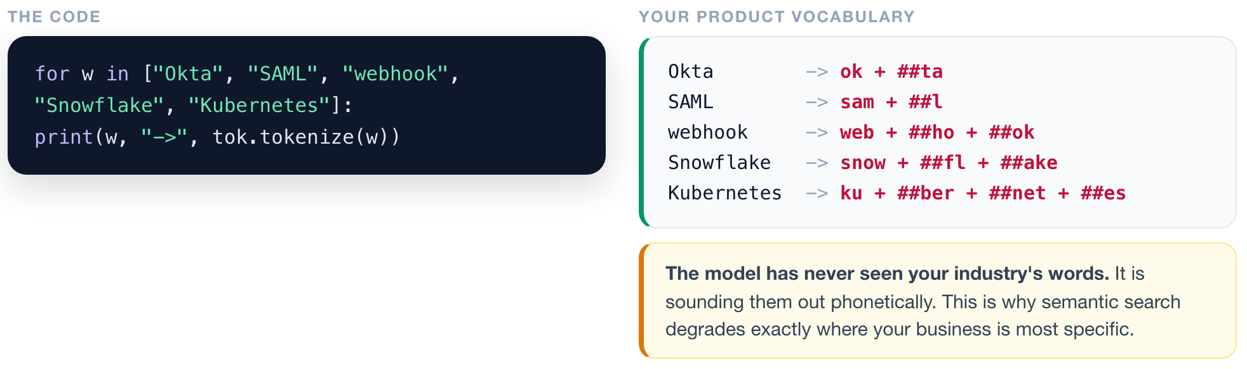
REPRESENT
1
2
3
4
Check what happens to your business vocabulary.
▶ NOTEBOOK
STEP 7
Test your product vocabulary
ISBA 2411 · Natural Language Processing & AI · Summer 2026
Notes:
[6:04 PM to 6:08 PM ~4 min]
TO THE NOTEBOOK: STEP 7 · Test your product vocabulary
Now here is why you should care, and this is the first genuinely useful thing you can take to work.
Let me run your product vocabulary through that same tokenizer. Okta becomes "ok" plus "ta". SAML becomes "sam" plus "l". Webhook becomes three pieces. Kubernetes shatters into four.
Look at what just happened. The model has never seen your industry's words. It is sounding them out phonetically, like somebody reading a foreign name off a page. Snowflake is not a data warehouse to this model. It is snow, plus fl, plus ake.
So when a vendor tells you semantic search will work beautifully on your data, this is the two minute test that tells you whether they are right. It degrades exactly where your business is most specific: product names, error codes, part numbers, drug names, legal citations. Run the tokenizer first.

Slide 8
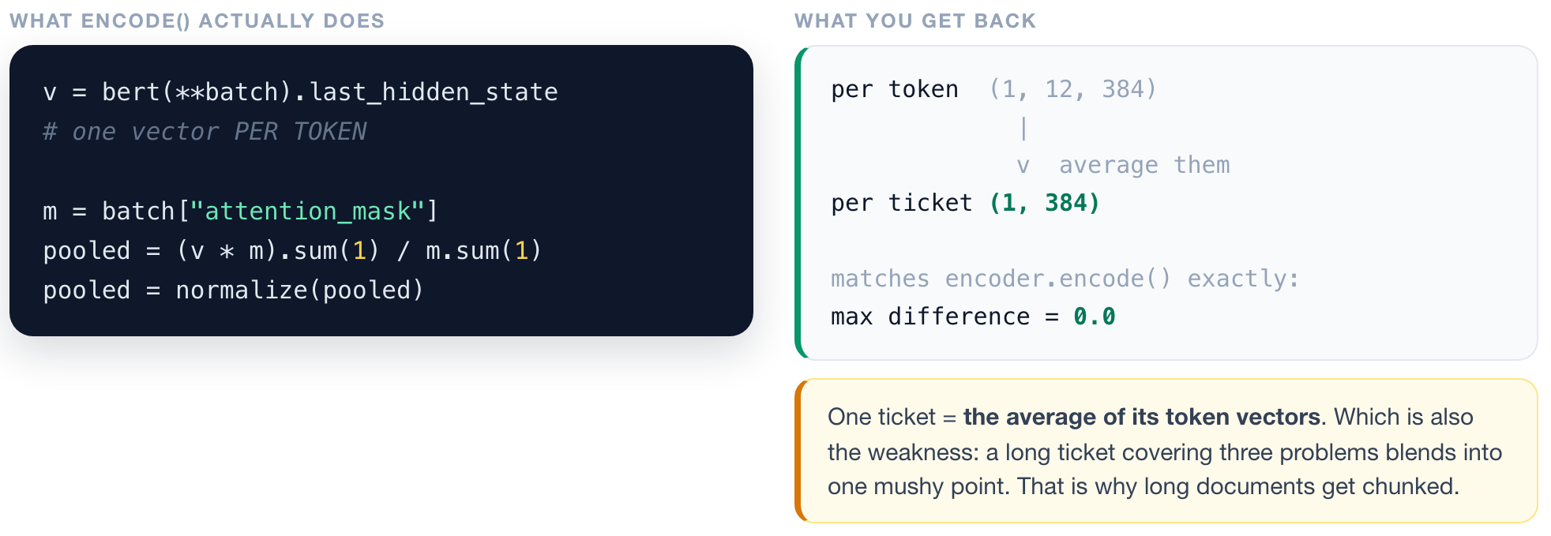
REPRESENT
1
2
3
4
One ticket becomes one vector, by averaging.
▶ NOTEBOOK
STEP 8
Pool tokens into one vector
ISBA 2411 · Natural Language Processing & AI · Summer 2026
Notes:
[6:08 PM to 6:12 PM ~4 min]
TO THE NOTEBOOK: STEP 8 · Pool tokens into one vector
Tokens become vectors, one per token. But we need one vector per ticket, not one per token. So how do we get from twelve token vectors down to one?
We average them. That is genuinely it. Add them up, divide by how many there are, scale the result to length one.
When we do that by hand in the notebook and compare it to the library's one-line function, the difference is exactly zero. Not approximately zero. Zero. It is the same arithmetic, just written out.
And notice the weakness that exposes. A ticket's vector is an average. If a customer writes three unrelated complaints in one ticket, all three blend into a single mushy point that is not really about any of them. That is why long documents get chopped into chunks before you embed them, and it is going to matter a great deal when we get to retrieval next week.

Slide 9
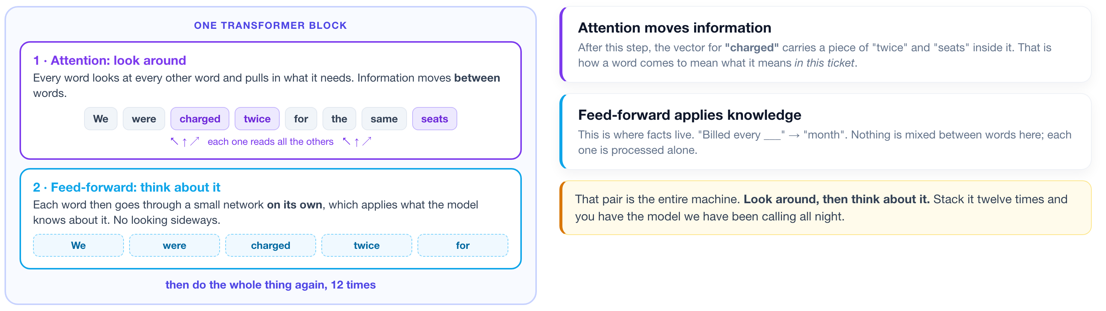
INSIDE THAT ONE LINE
1
2
3
4
What actually happened inside bert(...)?
You just called a transformer and got vectors back. Ninety seconds on what it did with them.
▶ NOTEBOOK
STEP 9
Watch attention change a word
ISBA 2411 · Natural Language Processing & AI · Summer 2026
Notes:
[6:12 PM to 6:15 PM ~3 min]
TO THE NOTEBOOK: STEP 9 · Watch attention change a word
Stop for a second, because we just used a transformer and I have not told you what one is.
Look back at that line: bert of batch, dot last hidden state. Tokens went in, vectors came out. What happened in between? It is two things, repeated. That is genuinely all a transformer is.
The first half is called attention, and its job is to let the words look at each other. Every word reads every other word in the ticket and pulls in whatever it needs. So the word "charged" reads "twice" and "seats" and comes out carrying a piece of both. Information moves sideways, between words.
The second half is the feed-forward network, and it does the opposite. Each word now goes off on its own, through a small network, with no looking sideways at all. This is where the model applies what it knows about that word.
So: look around, then think about it. Attention gathers the context, feed-forward applies the knowledge. That pair is one block, and BERT stacks twelve of them. When you hear somebody say a model is "twelve layers deep", that is what they mean. Twelve rounds of look around, then think about it.
That is the whole architecture. Everything else you may have heard, the queries and keys and the square roots, is detail inside the first half.

Slide 10
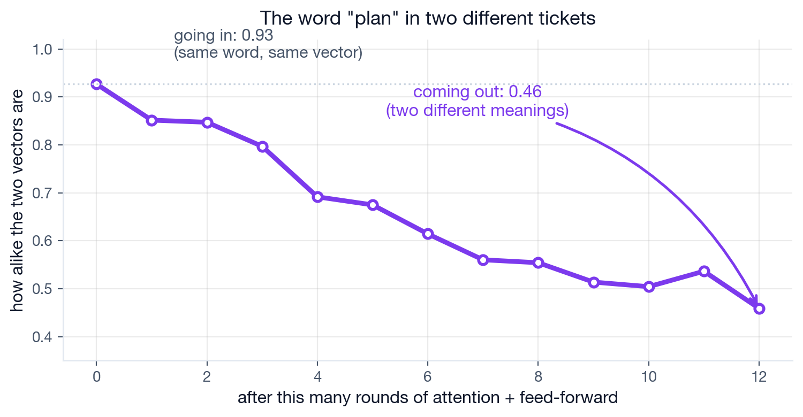
THE ATTENTION HALF
1
2
3
4
A word absorbs the words around it.
"Plan" is a subscription tier in one ticket and an intention in another. Same word, same starting vector.
Going in they are 0.93 alike. Twelve rounds later, 0.46. That gap is attention doing its job.
▶ NOTEBOOK
STEP 9
Watch attention change a word
ISBA 2411 · Natural Language Processing & AI · Summer 2026
Notes:
[6:15 PM to 6:19 PM ~4 min]
TO THE NOTEBOOK: STEP 9 · Watch attention change a word
Let me prove the attention half actually does what I just claimed, because it is easy to say "words look at each other" and hard to believe.
Here is the word "plan" in two of our tickets. In the first, "we want to move to the Team plan next month", plan means a subscription tier. In the second, "we plan to migrate our database next week", plan means an intention. Completely different meanings, identical spelling.
Now watch the chart. On the left, before any layers run, the two vectors for "plan" are zero point nine three alike. Almost identical, because at that point it is literally the same word looking up the same row in the same table. The model has no idea there is a difference.
Then each round of attention lets it read the neighbours. "Team" and "month" pull the first one one way. "migrate" and "database" pull the other one the other way. And the line falls. Layer four, zero point six nine. Layer eight, zero point five five. By layer twelve, zero point four six. They are barely related any more.
That gap, from zero point nine three down to zero point four six, is attention doing its job. The model figured out that these are two different words that happen to be spelled the same, and nobody told it. It read the neighbours.
And now you know why the search from earlier worked. It was never matching spellings. It was matching vectors that already knew what the sentence was about.

Slide 11
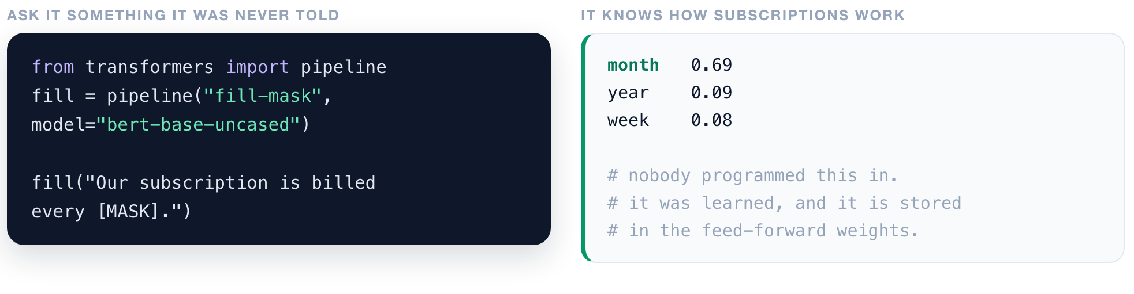
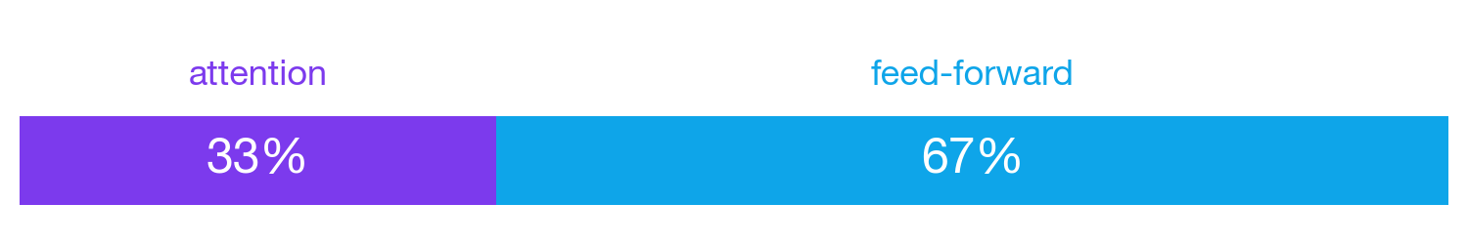
THE FEED-FORWARD HALF
1
2
3
4
Where the model keeps what it knows.
Two thirds of every layer is feed-forward, only a third is attention. Attention gets the headlines; the knowledge lives next door.
▶ NOTEBOOK
STEP 10
Find where the knowledge is stored
ISBA 2411 · Natural Language Processing & AI · Summer 2026
Notes:
[6:19 PM to 6:22 PM ~3 min]
TO THE NOTEBOOK: STEP 10 · Find where the knowledge is stored
Now the other half, and this is the part almost nobody talks about.
After attention has mixed the words together, each word goes through a small network on its own. No looking sideways. This is where the model applies what it has stored.
Let me show you that it has stored something. I am going to blank out a word and ask it to fill in the gap. "Our subscription is billed every blank." I never trained it on Cobalt. I never told it anything about subscriptions.
[run it] Month, at sixty nine percent. Then year, then week. It knows how subscriptions work, because it read most of the internet and subscriptions get billed monthly. That knowledge is not in the attention half. It is sitting in the feed-forward weights.
And here is the fact that surprises people, including me the first time. Look at the bar. Two thirds of every layer is feed-forward. Only a third is attention. Attention gets all the headlines and all the papers and the famous title, but the majority of the model, by weight, is the boring part that stores knowledge.
So keep both halves in your head. Attention decides what to mix. Feed-forward supplies what it knows. You need both, and the second one is bigger.

Slide 12
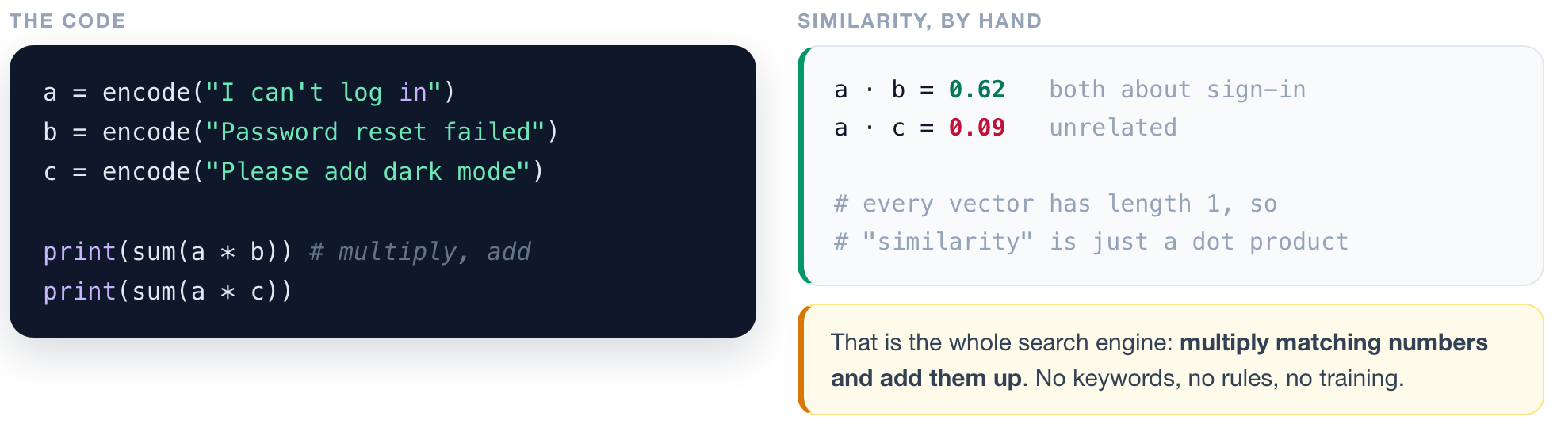
RETRIEVE
1
2
3
4
Similarity is a multiplication.
▶ NOTEBOOK
STEP 11
Measure similarity by hand
ISBA 2411 · Natural Language Processing & AI · Summer 2026
Notes:
[6:22 PM to 6:25 PM ~3 min]
TO THE NOTEBOOK: STEP 11 · Measure similarity by hand
So every ticket is now a point in space. How do we measure whether two tickets are about the same thing? We multiply and add.
Because every vector was scaled to length one, similarity is just the dot product: multiply the matching numbers, sum them up. "I can't log in" and "password reset failed" score zero point six two. "I can't log in" and "please add dark mode" score zero point zero nine.
That number is the entire search engine. No keywords, no rules, no if-statements, no training. One multiplication.

Slide 13
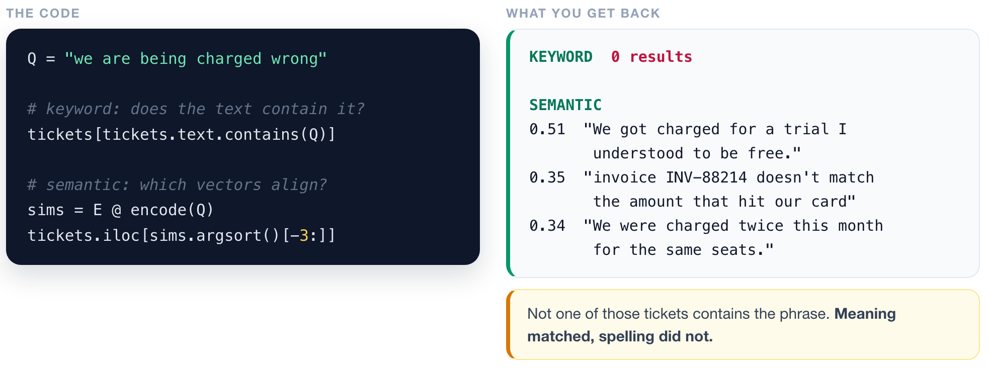
RETRIEVE
1
2
3
4
Search that finds what you meant.
▶ NOTEBOOK
STEP 3
Turn tickets into vectors, then search
ISBA 2411 · Natural Language Processing & AI · Summer 2026
Notes:
[6:25 PM to 6:29 PM ~4 min]
TO THE NOTEBOOK: STEP 3 · Turn tickets into vectors, then search (scroll back up)
Let me show you why that matters.
I am going to search the inbox for "we are being charged wrong". First, keyword search. Zero results. Not one ticket contains that phrase, because real customers do not write the phrase you happened to think of.
Now semantic search, same query. Back come "we got charged for a trial I understood to be free", "invoice does not match the amount that hit our card", "we were charged twice this month for the same seats". None of those contain the words I typed. Meaning matched. Spelling did not.
This is a feature you have used a hundred times without thinking about it. Every help centre search that actually works, every "related tickets" sidebar, every internal wiki that finds the right document. It is this.

Slide 14
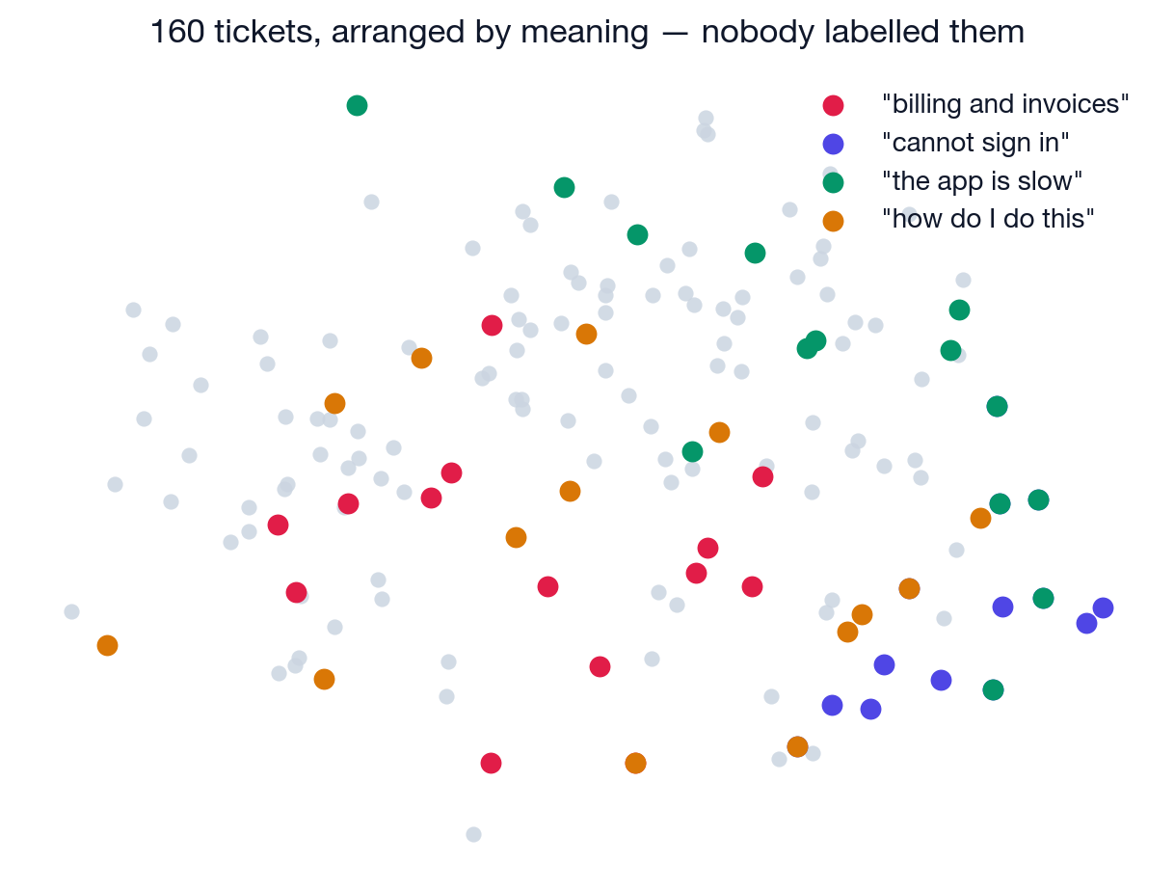
RETRIEVE
1
2
3
4
Structure was already in the text.
Nobody sorted these. Plot the vectors and the neighbourhoods appear on their own.
▶ NOTEBOOK
STEP 5
Map the whole inbox
ISBA 2411 · Natural Language Processing & AI · Summer 2026
Notes:
[6:29 PM to 6:32 PM ~3 min]
TO THE NOTEBOOK: STEP 5 · Map the whole inbox (scroll back up)
One more thing before we move on. If every ticket is a point, we can flatten those points onto a page and look at the entire inbox at once.
Here are all one hundred and sixty. The grey dots are every ticket. Then I asked for the fourteen nearest neighbours of four different phrases and coloured those in.
Look at what happened. The billing tickets cluster together. The sign-in tickets cluster. The slow-and-broken tickets cluster. Nobody sorted any of this. I never told the model these categories existed. That structure was already sitting in the text, and all we did was make it visible.
The practical version: you can walk into a leadership meeting and show them what is inside a pile of feedback before spending one dollar on hand-sorting.

Slide 15
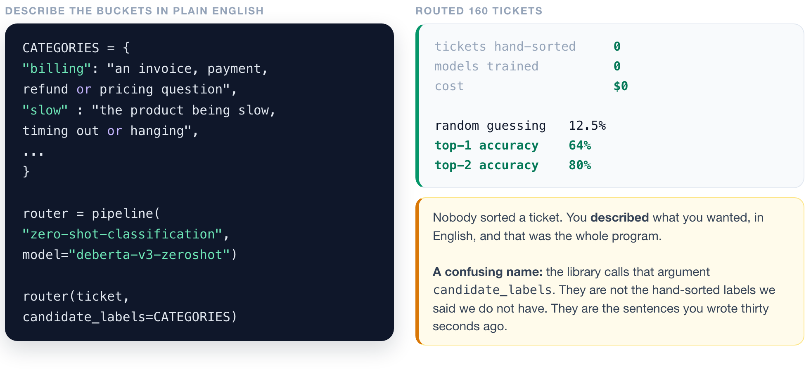
ROUTE
1
2
3
4
Sort the inbox with no training data at all.
▶ NOTEBOOK
STEP 13
Route the inbox with no training data
ISBA 2411 · Natural Language Processing & AI · Summer 2026
Notes:
[6:32 PM to 6:37 PM ~5 min]
TO THE NOTEBOOK: STEP 13 · Route the inbox with no training data
Now the interesting part. We want to sort the inbox into the buckets our support team actually uses. The textbook answer is: hand-sort a few thousand tickets, then train a classifier. That is weeks of work and money Cobalt does not have.
One thing to head off before it confuses somebody. In the code you will see an argument called candidate underscore labels. Those are not the hand-sorted labels I just told you we do not have. Nobody sorted a ticket. They are the sentences we write, in English, in about a minute. The library just picked an unfortunate name.
So we do it differently. Watch what the program looks like. I write out each bucket as a description in plain English. "An invoice, payment, refund or pricing question." "The product being slow, timing out or hanging." That is the code. That is the whole program. Then one pipeline call. There is no training step anywhere.
Before I run it, commit to a prediction. Eight buckets, so random guessing is twelve and a half percent. What would you bet on?
[run it] Sixty four percent on its single best guess, and eighty percent if you let it offer two. Nobody sorted a ticket. Nothing was trained. Zero dollars.
Now read that eighty percent as a product instead of a metric. It means you show your agent two buttons instead of eight.

Slide 16
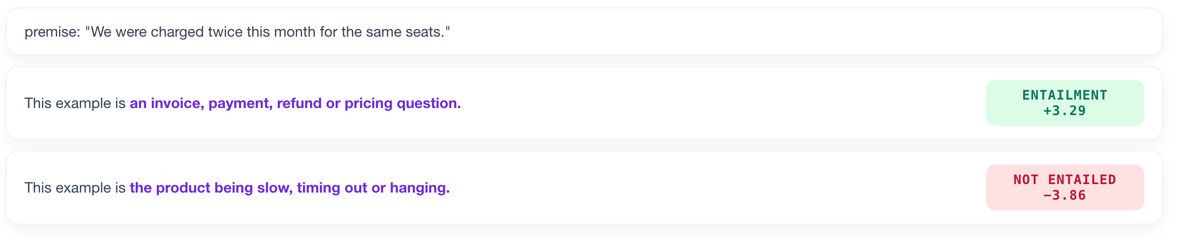
ROUTE
1
2
3
4
It is not a classifier. It is a fact-checker.
The model judges whether a sentence YOU wrote is true of the ticket.
Every category becomes a sentence: "This example is {your description}." The model scores all eight and picks whichever it most believes.
▶ NOTEBOOK
STEP 17
See the entailment scores
ISBA 2411 · Natural Language Processing & AI · Summer 2026
Notes:
[6:37 PM to 6:42 PM ~5 min]
TO THE NOTEBOOK: STEP 17 · See the entailment scores
You should be slightly suspicious right now. How can a model sort tickets into categories it has never seen before? Here is the answer, and it is my favourite thing in this lecture.
It is not a classifier. It is a fact-checker.
This model was trained on a task called natural language inference. You give it two sentences and it decides whether the first one makes the second one true. Entailment, or not. That is all it does.
The zero-shot trick is to smuggle classification into that format. The premise is the ticket. The hypothesis is a sentence we build: "This example is", plus your description. Then it just answers true or false.
Look at the two rows. For the billing description the entailment score is plus three point two nine, strongly true. For the slow-and-timing-out description it is minus three point eight six. The sign flips. It scores all eight sentences and picks whichever one it believes most.

Slide 17
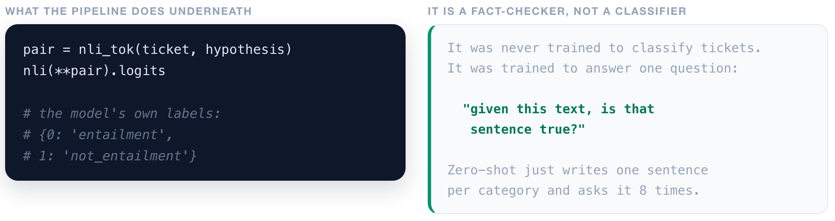
ROUTE
1
2
3
4
Underneath the one-line pipeline.
▶ NOTEBOOK
STEP 17
See the entailment scores
ISBA 2411 · Natural Language Processing & AI · Summer 2026
Notes:
[6:42 PM to 6:45 PM ~3 min]
TO THE NOTEBOOK: STEP 17 · See the entailment scores
Here is what that looks like underneath the one-line pipeline. You tokenize the ticket and the hypothesis together as a pair, run the model, and read two numbers. The model's own output labels are literally "entailment" and "not entailment".
That is the whole mechanism.
So when you meet one of those "just describe what you want" AI tools, and there are a lot of them now, this is usually what is happening underneath. A model is scoring your words.

Slide 18
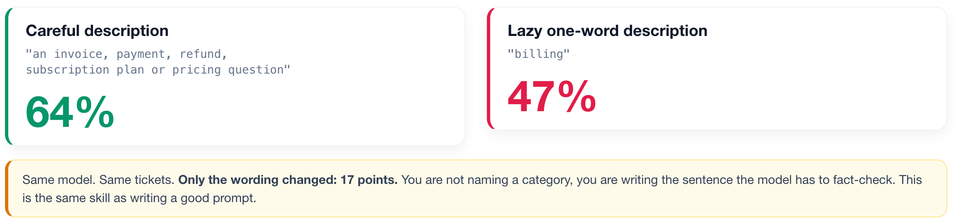
ROUTE
1
2
3
4
The descriptions you write ARE the program.
▶ NOTEBOOK
STEP 16
YOUR KNOB: rewrite the descriptions
ISBA 2411 · Natural Language Processing & AI · Summer 2026
Notes:
[6:45 PM to 6:49 PM ~4 min]
TO THE NOTEBOOK: STEP 16 · YOUR KNOB: rewrite the descriptions
Which brings us to the single most practical thing tonight. If the descriptions are the program, then how you write them is engineering.
Watch. On the left, careful descriptions: sixty four percent. On the right, I replaced them with lazy one-word descriptions. Just "billing". Just "bug". Forty seven percent.
Same model. Same tickets. Same code. Only the wording changed, and it cost seventeen points of accuracy.
Why? Because you are not naming a category. You are writing a sentence the model has to judge true or false, and "billing" is much harder to judge than "an invoice, payment, refund or pricing question".
This is exactly the same skill as writing a good prompt. Precision in writing is not a soft skill here. It is the program.

Slide 19
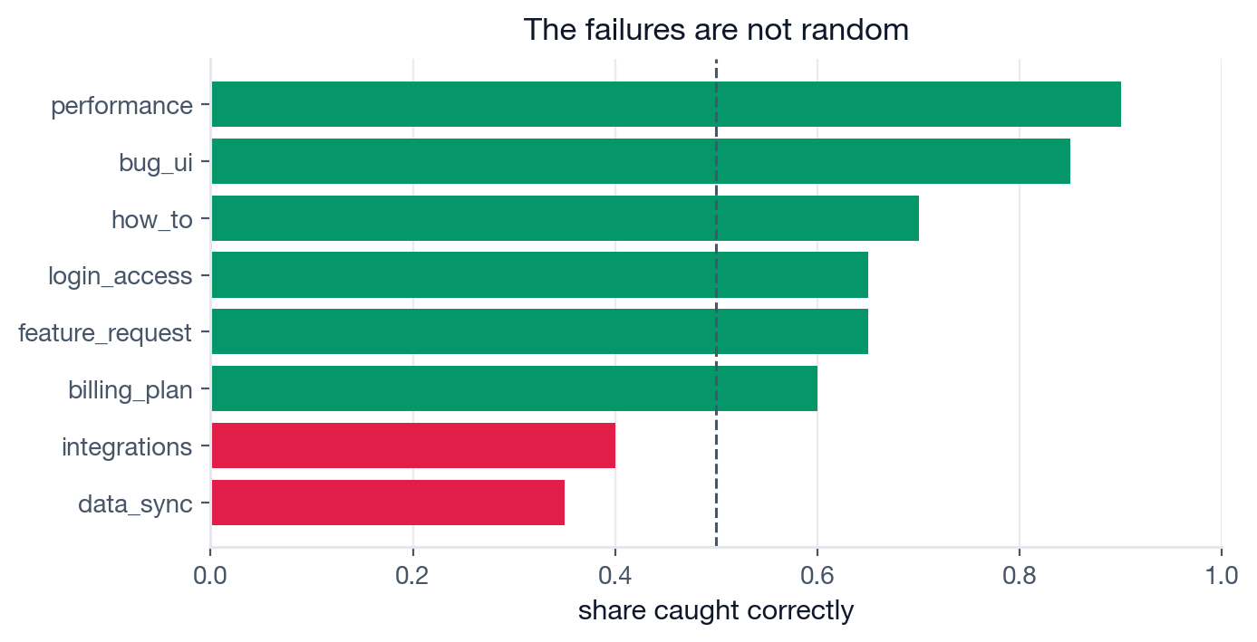
DECIDE
1
2
3
4
An average is a bad way to run a product.
Ask WHICH tickets it gets wrong. The weak buckets are the ones whose descriptions overlap.
When a classifier underperforms, look at your taxonomy before you look at your model.
▶ NOTEBOOK
STEP 18
Find the weak buckets
ISBA 2411 · Natural Language Processing & AI · Summer 2026
Notes:
[6:49 PM to 6:53 PM ~4 min]
TO THE NOTEBOOK: STEP 18 · Find the weak buckets
Now let us be honest about sixty four percent, because an average is a terrible way to run a product. The question is not "how accurate is it". The question is "which tickets does it get wrong, and do I care".
Here is the per-bucket breakdown. Green is fine, red is broken. How-to and feature requests are strong. Data sync is the worst by a mile.
And when I pull up the actual mistakes, the pattern is obvious. Data sync tickets are being sent to the UI bug bucket. Look at why. "The row counts do not match our warehouse." Is that a data sync problem, or is that something displaying the wrong number? Honestly, it is both. My two descriptions overlap.
The model is not confused. My categories are.
So write this one down: when a classifier underperforms, look at your taxonomy before you look at your model. Categories should describe what the customer wants done, not which internal component broke.

Slide 20
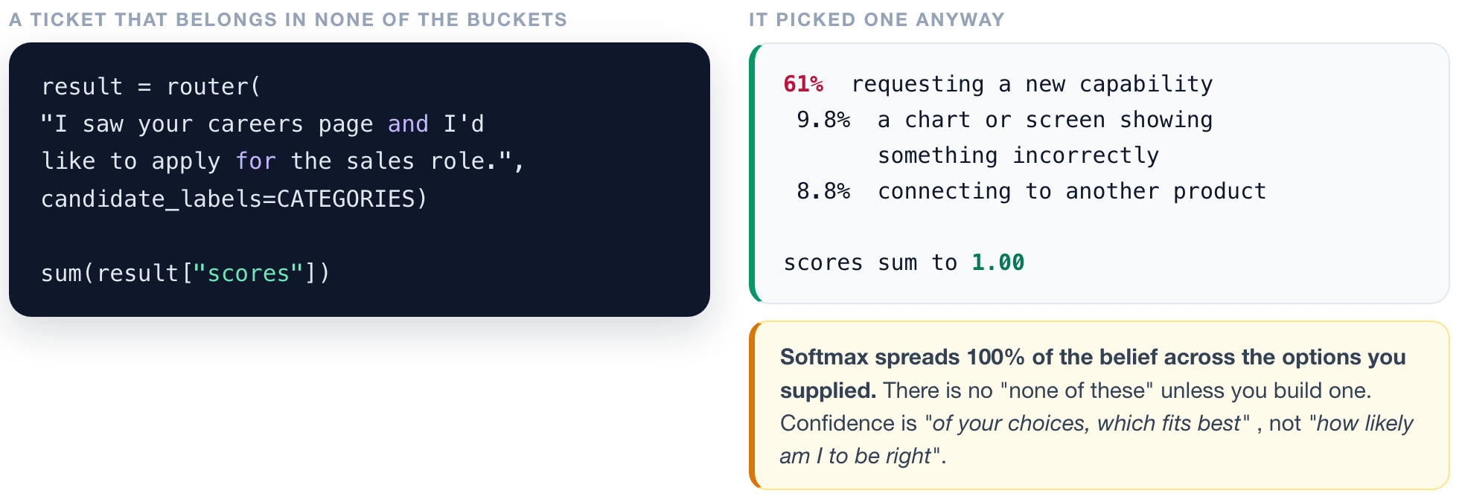
DECIDE
1
2
3
4
Confident is not the same as correct.
▶ NOTEBOOK
STEP 19
Feed it an off-topic ticket
ISBA 2411 · Natural Language Processing & AI · Summer 2026
Notes:
[6:53 PM to 6:58 PM ~5 min]
TO THE NOTEBOOK: STEP 19 · Feed it an off-topic ticket
Here is the thing that should genuinely worry you, and it is the most important slide tonight.
Those data sync tickets were not misrouted with a shrug. The model was ninety four percent, ninety nine percent confident, and wrong. Confidently wrong is far more dangerous than uncertain.
Let me show you why that happens. I am going to feed it a ticket that belongs in none of our eight buckets: somebody applying for a job. Predict what happens.
[run it] It says "feature request", sixty one percent confident. And look at the bottom line: the scores sum to one point zero zero.
There it is. The final step is a softmax, and a softmax spreads one hundred percent of the belief across the options you supplied. It has to pick a winner. There is no "none of these" unless you build one.
So that confidence number does not mean "how likely am I to be right". It means "of the choices you gave me, this one fits best". A confident wrong answer is exactly what you get when every option is bad.
Practical rule: never show a raw confidence score to a user as if it were a probability of correctness, and never let one gate an action you cannot undo.

Slide 21
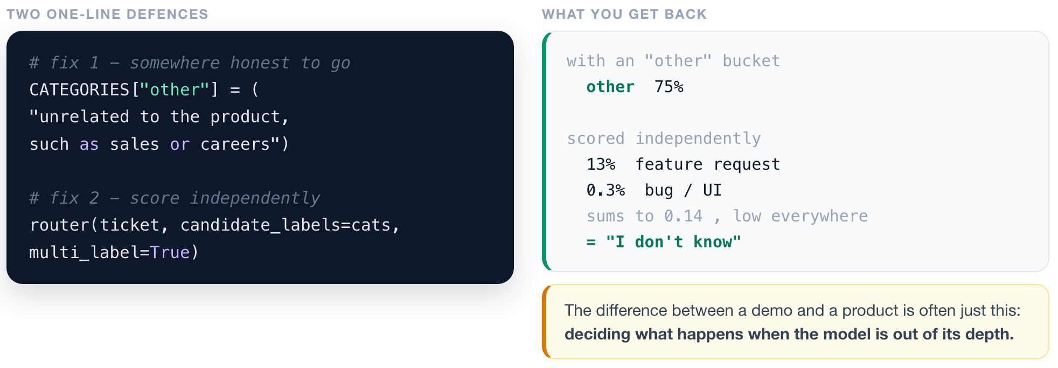
DECIDE
1
2
3
4
Give the model a way to say "I don't know".
▶ NOTEBOOK
STEP 20
Add the two defences
ISBA 2411 · Natural Language Processing & AI · Summer 2026
Notes:
[6:58 PM to 7:02 PM ~4 min]
TO THE NOTEBOOK: STEP 20 · Add the two defences
Two fixes, one line each.
First, give the model somewhere honest to go. I add an "other" bucket, described as "unrelated to the product, such as sales or careers". Re-run the job application and it lands in "other" at seventy five percent. Fixed.
Second, and this one is subtler: stop making it choose. Switch to multi-label, which scores every category independently instead of forcing them to compete. Now the job application scores thirteen percent on its best category, and the total is zero point one four. Low on everything. That is the model saying "I do not know", which is enormously more useful than a confident wrong answer.
The difference between a demo and a product is very often just this: deciding what happens when the model is out of its depth. Good question to ask any vendor: what does your system do with an input it has never seen?

Slide 22
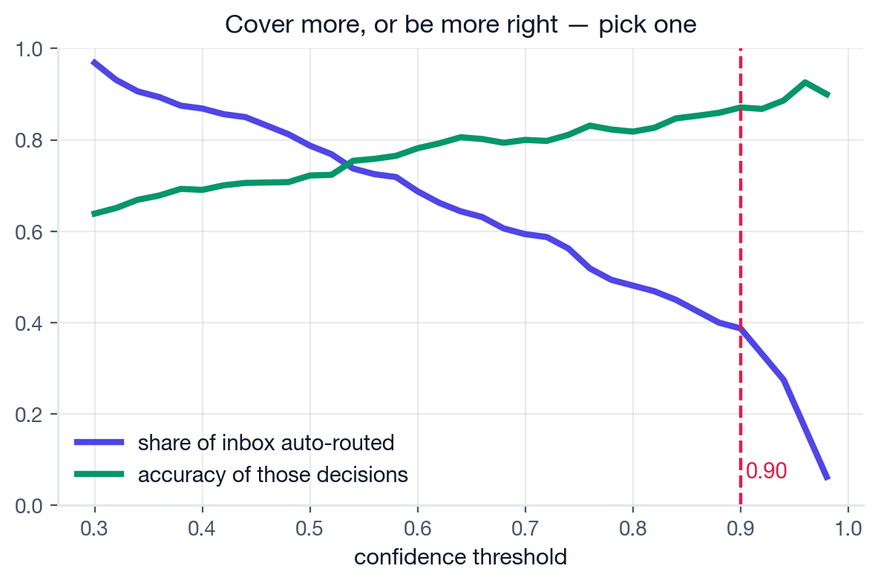
DECIDE
1
2
3
4
This curve is the business decision.
There is no setting that maximises both. Where you stand on it is a judgement about cost.
SET IT AT 0.90 AND SHIP
39%
of the inbox handled automatically
87%
accurate on those decisions
~1,937
tickets a week nobody has to touch
"We can automate 39% of the inbox at 87% accuracy, or cover far more and be less right." That is a decision an executive can actually make.
▶ NOTEBOOK
STEP 21
YOUR KNOB: set the threshold
ISBA 2411 · Natural Language Processing & AI · Summer 2026
Notes:
[7:02 PM to 7:07 PM ~5 min]
TO THE NOTEBOOK: STEP 21 · YOUR KNOB: set the threshold
Last capability. You do not have to route everything. Route only what the model is sure about, and send the rest to a human. That is one number, and this curve is what it does.
Purple is the share of the inbox you auto-route. Green is how accurate those decisions are. They move in opposite directions, and there is no setting that maximises both. Set the bar low and you automate almost everything, badly. Set it high and you automate a little, very well.
This curve, not an accuracy number, is what you take into the room. "We can automate thirty nine percent of the inbox at eighty seven percent accuracy, or cover far more and be less right." That is a sentence an executive can actually make a decision about.
And notice: the right answer depends entirely on what a misroute costs you versus what an agent's hour is worth. That is a business question, not a modelling question.
And let us put a number on it. Threshold at zero point nine. Thirty nine percent of the queue auto-routed, eighty seven percent accurate on those. At five thousand tickets a week that is about nineteen hundred a week that nobody has to touch. With no training data, no training run, and no GPU bill.

Slide 23
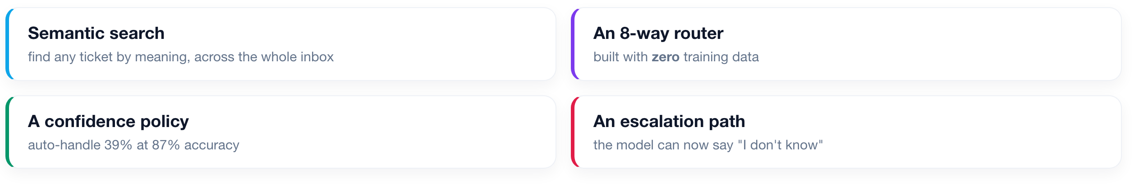
FULL CIRCLE
What we shipped today, for $0.
No training data. No training run. No GPU bill. One afternoon.
Someone else already spent millions teaching a model to read English. Your job is not to build intelligence. It is to point it at your problem, cheaply, and know where it breaks.
ISBA 2411 · Natural Language Processing & AI · Summer 2026
Notes:
[7:07 PM to 7:10 PM ~3 min]
Full circle. Here is what we built tonight.
Semantic search across the whole inbox. An eight-way router built with no training data at all. A confidence policy that decides what ships automatically. And an escalation path, so the system can admit when it does not know.
Total cost of hand-sorting tickets: zero dollars.
And here is the one idea I want you to leave with. Somebody else already spent millions of dollars teaching a model to read English. You do not have to build intelligence. Your job is to point it at your problem, cheaply, and know where it breaks.

Slide 24
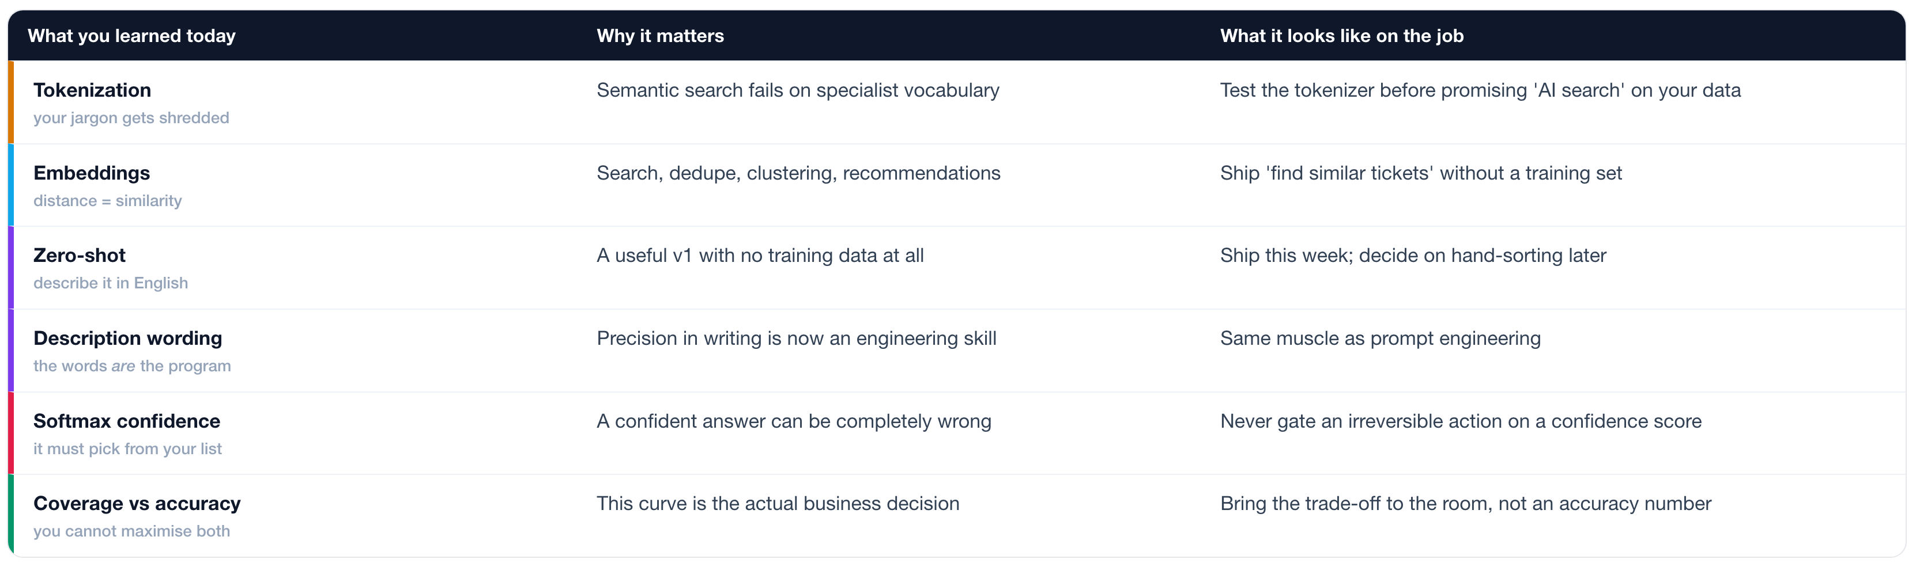
WHY THIS MATTERS AT WORK
Six instincts, not six tools.
Every row is a call your future team needs someone in the room able to make.
ISBA 2411 · Natural Language Processing & AI · Summer 2026
Notes:
[7:10 PM to 7:14 PM ~4 min]
Let me translate all of that into sentences you can actually say in a meeting, because that is the part that gets you hired.
Take the third row. You now know you can ship a useful classifier with no training data. So when somebody says "we cannot start until we have labelled data", you know that is often just not true.
Or the fifth row: a confident answer can be completely wrong, so you never wire a confidence score to an irreversible action.
Or the last one: coverage and accuracy trade off against each other, so what you hand your boss is a curve, not a number.
None of these are facts about transformers. They are instincts about building products with them, and this morning you did not have them.

Slide 25
NEXT TIME
The layer that acts.
What if we DO sort them by hand?
a few hundred examples, and what they buy you
Where the reading came from
BERT, and how pretraining actually worked
Pull out the specifics
which feature, what error, which plan
Watch it make things up
and why that sets up Week 8
Notebook: L13_Cobalt_Support_Copilot.ipynb. Run it, turn the knobs, break it.
ISBA 2411 · Natural Language Processing & AI · Summer 2026
Notes:
[7:14 PM to 7:16 PM ~2 min]
Thursday we build the other half. Four things.
First: what actually happens if we do invest in labelling a few hundred tickets. Is it worth it?
Second: where tonight's reading ability came from, which is BERT and masked language modelling.
Third: pulling out specifics, so instead of "this is a data problem" we get "the Postgres connector, error code SYNC_TIMEOUT, on the Business plan".
And fourth, the one that sets up Week 8: we watch the model invent a refund policy that does not exist, with total confidence.
The notebook is on Canvas and on GitHub. Run it, turn the knobs, and try to break it. That is where this goes from "I watched it" to "I get it".

